Slide 1
The Mughal Empire
Preview
Main Idea / Reading Focus
Muslim Rule in India
A New Empire
Faces of History: Akbar
Height of the Mughal Empire
Quick Facts: Achievements of the Mughal Emperors
Map: Mughal Empire

Slide 2
Muslim Rule in India
After the fall of the Gupta Empire in the 500s, India broke apart into a number of small kingdoms.
The Arrival of Islam
Muslim Raiders
During period of small kingdoms, Arab Muslim traders arrived in India for first time
Traders sailed to ports on west coast in search of goods such as spices
Over time, traders settled in India, lived peacefully beside Hindus, Buddhists
Next Muslims to arrive not so peaceful
Early 700s, Muslim raiders invaded, conquered region of Sind, in what is now Pakistan
300 years later, Muslims poured into north India from Afghanistan
By 1200s, most of northern India under Muslim control

Slide 3
Delhi Sultanate
Once Muslims took control of north India, established new government for region based in city of Delhi
Government became known as Delhi sultanate
Rulers in sultanate tolerant, allowed traditional customs, religions
Blending of Cultures
Rulers also worked to spread Muslim culture through India
Invited artists, scholars from other parts of Islamic world to Delhi
New culture formed, blending Muslim, Indian elements
Example: new language, Urdu, formed from combination of Arabic, Sanskrit

Slide 4
A New Empire
The Delhi sultanate remained strong for about 300 years.
By the early 1500s, its power was weakening.
This weakening left India open to invasion.
Babur
Mughal Empire
Wealth, Power
Young Central Asian conqueror named Zahir ud-Din, better known as Babur, “the tiger,” took advantage of India’s weakness
Tried, failed to create empire in Central Asia
Next turned to India
By 1526, had defeated rulers of Delhi, founded Mughal Empire
Name comes from Persian word Mogul for “Mongol”
Mughals reigned as India’s first great Muslim empire
Great civilization, known for wealth, power

Slide 5
Akbar the Great
Babur’s Grandson
Babur died shortly after conquest of India, task of organizing what he conquered fell to descendants
Most done by grandson, Akbar the Great
Diverse Population
Akbar took throne at age 13, but became greatest of all Mughal rulers
Realized India had diverse population, which could lead to breakdown of empire; did everything he could to win people’s loyalty
Expanding Rule
Akbar married daughter of local noble to win noble’s support
Brought sons of other nobles to live at court
Did not hesitate to fight to prevent rebellion
1605, Akbar died; at time, Mughals ruled most of north India, much of interior

Slide 6
Akbar’s Achievements
Religious Tolerance
Akbar worked to unify diverse empire by promoting religious tolerance
Held that no one religion could provide all answers to life’s problems
Did not want to discourage people from practicing any religion, discriminate against anyone for their beliefs
Reforms
Firm Grip on Finances
Abolished taxes placed on non-Muslims by earlier rulers
Appointed Hindus to several influential positions in government
Encouraged discussions, debates among Muslims, Hindus, Christians, people of other religions
Established centralized government that gave him supreme civil, military authority over his empire
Reformed tax system, appointed officials to oversee it
Majority of officials from outside Mughal Empire

Slide 7
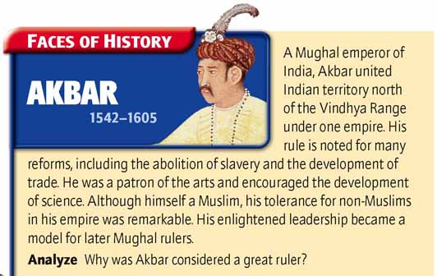

Slide 8
Height of the Mughal Empire
Jahangir
Rule
Babur, Akbar laid foundation for powerful empire
Rulers who followed built upon foundation, raised Mughal India to new heights of power, wealth
Akbar’s son, Jahangir, intelligent, impatient to rule, rebelled against father; later reconciled
In 1605 became emperor after Akbar’s death
Ruthless start, but good ruler
Continued religious tolerance; supported arts; adopted Persian influences into Indian society
Acceptance of Persian customs inspired by Persian-born wife, Nur Jahan
Powerful woman who ruled for several years while husband ill

Slide 9
Sikhism
During reign, Jahangir came into conflict with religious group, Sikhs
Some Sikhs had supported rebellion against Jahangir
Sikhism, blended elements of Islam, Hinduism
  Like Muslims, believe in one God, who created world, who has no physical form
  Unlike Muslims, who believe in afterlife, believe in reincarnation
  Believe goal of existence to be freed from cycle of rebirth, attain unity with God
  Do not practice rituals like pilgrimage, yoga, from the earlier religions

Slide 10
Shah Jahan
Jahangir’s son and successor, Shah Jahan shared his father’s love of literature and art.
During his reign the Mughal Empire experienced a cultural golden age.
Taj Mahal
Symbol of Mughal Majesty
Greatest example of Mughal architecture, Taj Mahal built during his reign
Designed by Persian architects, displays elements of Indian, Persian, Muslim architectural styles
Built as tomb for Shah Jahan’s wife
Shah Jahan also built new capital for India at Delhi
At heart, chamber that held magnificent Peacock Throne
Flanked by two sculpted peacocks, encrusted with gold, diamonds, emeralds, other gems
The cost of building monuments such as the Taj Mahal and the palaces of Delhi was enormous.

Slide 11
Taxes
Needed funds to pay for monuments
Shah Jahan imposed heavy taxes on people
Demanded half of all crops grown in the country
Led to hardship, famine for many
Wars
Series of wars against India’s neighbors also added to Shah Jahan’s need for money
Many wars fought in name of Islam against Christians, Hindus
Unlike father, grandfather, Shah Jahan was Muslim who did not practice religious tolerance

Slide 12
Aurangzeb
Power Struggle
1657, Shah Jahan grew terribly ill
Sons began to maneuver to take throne
Soon war broke out between them
Succession
Shah Jahan unexpectedly recovered but son Aurangzeb captured him
After locking father in prison, killed all rivals
Brought head of brother in box to show father; then declared himself emperor
Reign
Early in reign, concerned with expanding India’s borders
Empire reached greatest size at this time
Later, Aurangzeb turned more to domestic affairs

Slide 13
Domestic Affairs
Muslim Views
Worked to impose own strict religious views on society
Issued strict decrees about morality, personal behavior
Religious Persecution
Persecuted Hindus, Sikhs
Taxed them, forbade them high positions in government
Destroyed their temples
Crushing Protesters
Crowds of Shia, Sufi Muslims gathered to protest actions
Aurangzeb ordered soldiers mounted on elephants to crush them
God of All
Restrictions, persecution led many to rebel
One wrote: “God is the God of all mankind…not the God of Muslims alone.”

Slide 14
Decline of the Mughals
Civil War
Power and Territory Loss
Aurangzeb enlarged Mughal empire, however his actions marked beginning of its end
Due to harsh measures of regime, frequent rebellions broke out in later 1600s
When Aurangzeb died, rival claims to throne led to civil war
Soon invaders poured into India from north
Mughals continued to rule for about 150 more years, but held little power, controlled far less territory
Eventually India fell under colonial sway of British as part of their global empire

Slide 15
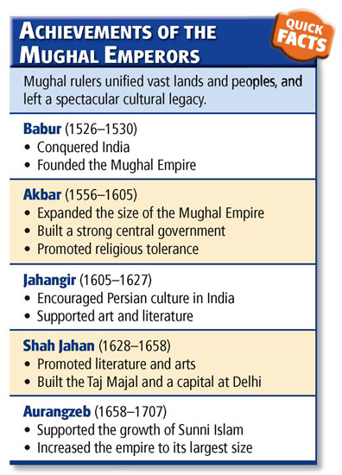

Slide 16
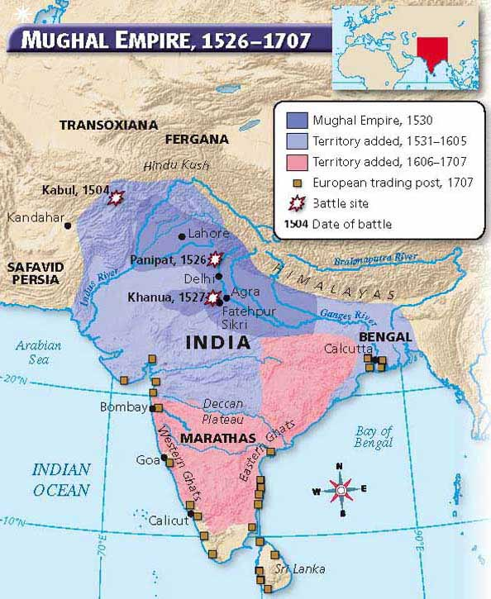

Slide 17
Source internet

